Slide 1

Housing Price Predictions Using Advanced Regression Techniques

Slide 2
Idea behind the problem statement
Alex want to buy a new house and he is getting multiple quotations from different property management and he is not able to understand what should be the correct price to pay for the house.
Should he just go ahead and buy the new house by considering whatever property management people are saying is correct ?
Consider the other way round – John wants to sell his house, how he will know that what would be the best price for his house ? so that can sell his house quickly and at optimum price.

Slide 3
Pre-processing and Feature Estimation
Clean outliers – For few columns we had outliers, which needs to dealt with
Impute missing values – Mean for quantitative, Mode and unknown class for categorical
Discretize categorical attributes – Categorical values are handled with box plot and OneHotEncoding to convert to numerical values
Transform skewed attributes – Used Standard scaler method to remove skewness
Select Attributes – Used Correlation, Backward elimination for feature selection

Slide 4
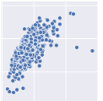
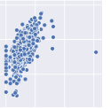

Clean Outliers

Slide 5
Impute missing value

Slide 6
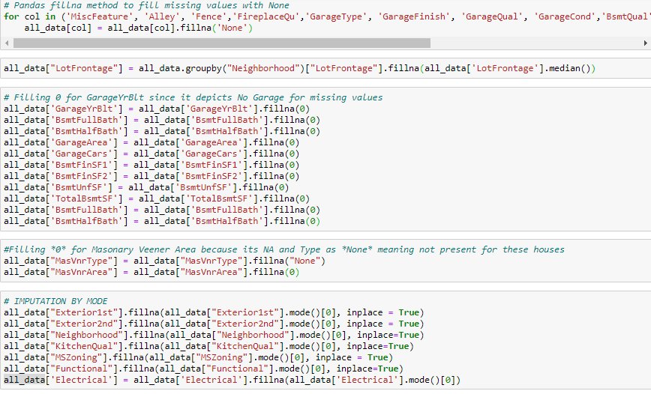
Quantitative values

Slide 7
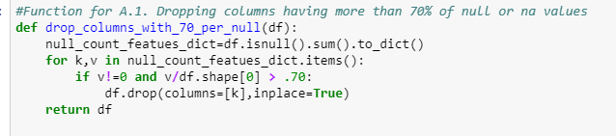
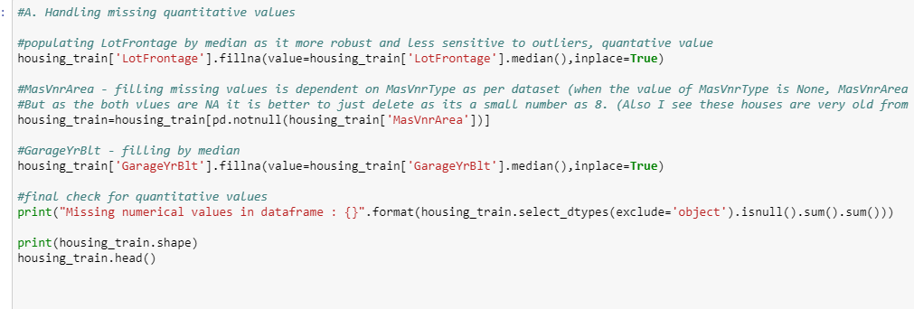
Quantitative values
Dropping columns having more than 70% of null values
Missing the missing quantitative values: Median as it is robust to outliers

Slide 8
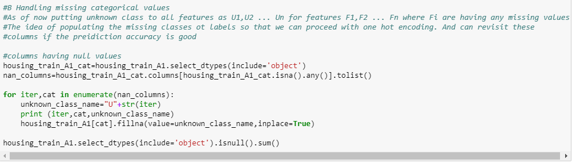
Imputing Categorical values
Putting Unknown classes as we don’t want to make the model bias

Slide 9
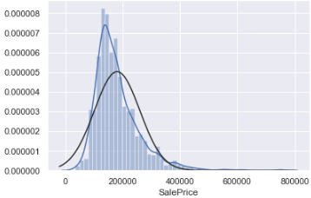
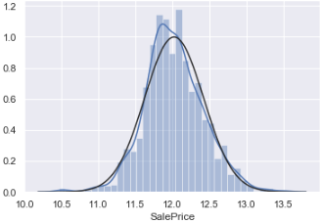
Transform Skewed Attributes

Slide 10
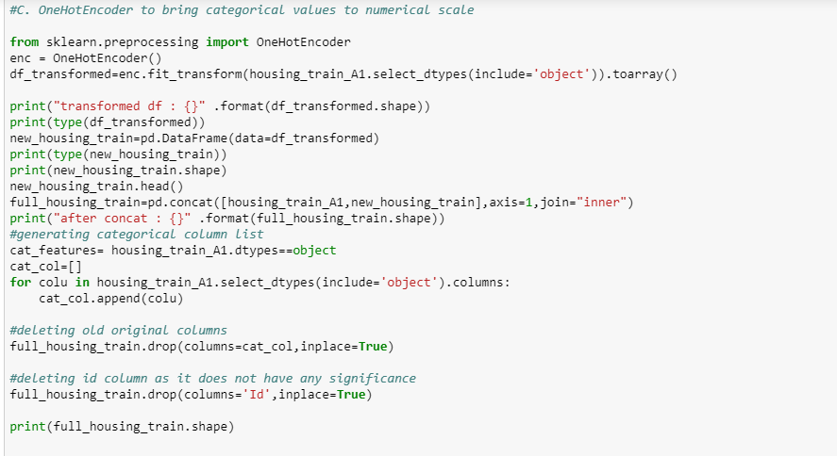
Converting Categorical to numerical
Applied One Hot Encoding (resulted in 283 columns)

Slide 11
Feature Reduction

Slide 12
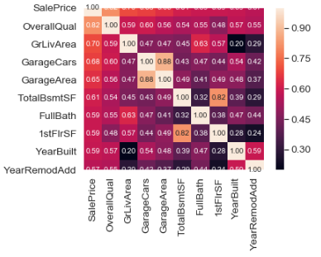
Pearson’s Correlation
Calculating correlation coefficients among attributes and eliminating one of the pair attributes whose value is greater than 0.7(dropped 12 columns)

Slide 13
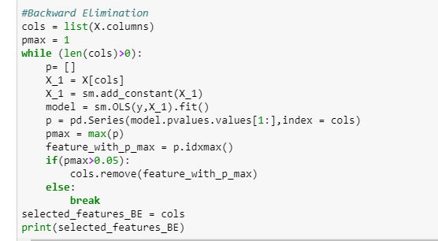
Backward Elimination
H0: There is no relation between Y and X
Ha: Y is dependent on X
if pvalue is less than significance level then reject null hypotheses
i.e. if pvalue > 0.05 we do need the columns (we got only 30 columns with this)

Slide 14
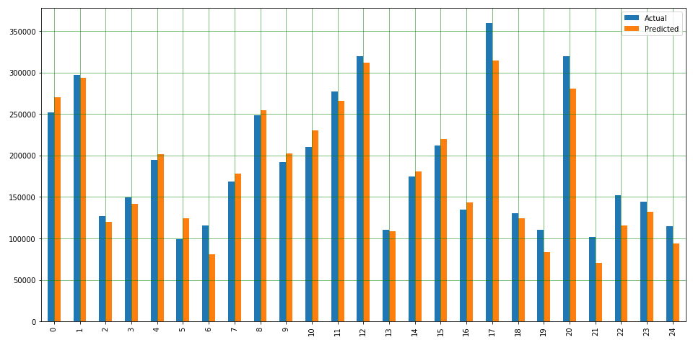
Machine Learning Models
1. Linear Regression (R2 = .78)

Slide 15
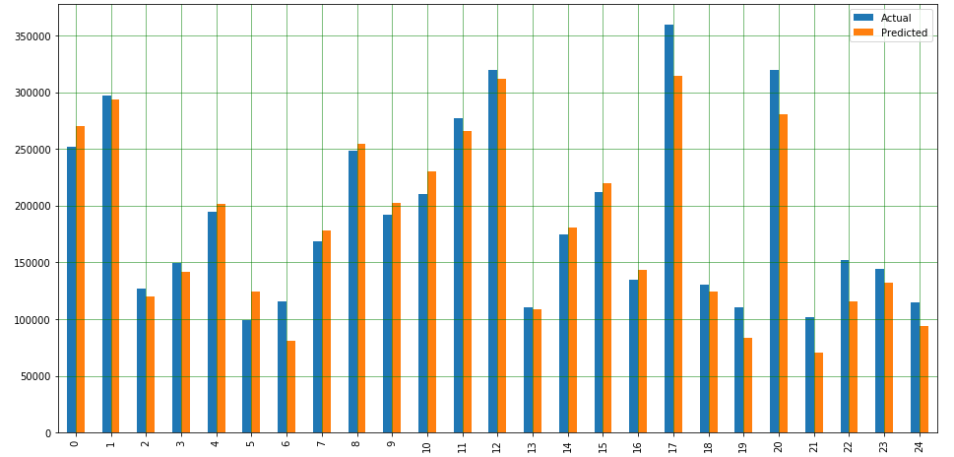
2. Random forest (R2 = .97)

Slide 16
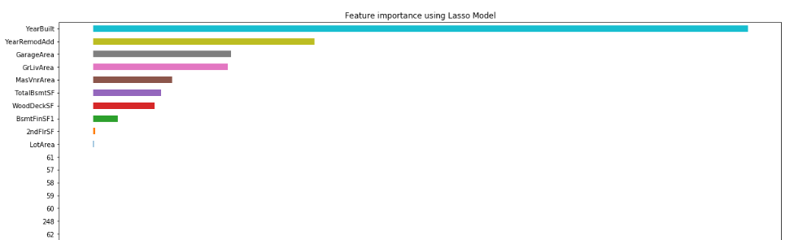
3. Lasso (R2 = .80)

Slide 17
Algorithm | R2 | Number of features
Linear Regression | 0.73 | With correlation 263, 30 with backward elimination
Random Forest | .97 | 30 features with backward Elimination
Lasso with Feature selection | .83 | 11 Features with high importance

Slide 18
We always have room for improvement
1. Gradient Boosting
2. Filling missing values with KNN
3. Neural Network

Slide 19
Questions and suggestions

